Slide 1
COMP208 FINAL REVIEW
EPTS COMP Tutor Shabbir Hussain

Slide 2
Useful Links
Course Summary:
http://s3.amazonaws.com/docuum/attachments/2086/comp%20208%20info.pdf?1240285685
Run C code online:
http://codepad.org/
http://www.compileonline.com/compile_c_online.php
Run Fortran code online:
http://www.compileonline.com/compile_fortran_online.php

Slide 3
Study Strategies
Do past finals
Check the course website
Start by doing the hardest questions first
Test your code on the computer
Make a cheat sheet (as an exercise)

Slide 4
Contents
Pointers
Trick Questions
Big O
Sorting
Recursion
Numerical Methods

Slide 5
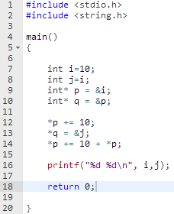
Pointers Example
What will be printed if we run this program?
Solve this problem as if you’re executing the code like a computer
Disclaimer: the techniques shown are not necessarily how the computer does it, but how you should do it on an exam
Notes:
#include <stdio.h>
#include <string.h>
main()
{
int i = 10;
int j = i;
int* p = &i;
int* q = &p;
*p += 10;
*q = &j;
*p += 10 + *p;
printf("%d %d\n", i ,j);
return 0;
}

Slide 6
Pointers Example
line 1 to 10 is just declarations.
Run till line 10 and build a table of variables:
Name | Value | Addr
i | 10 | &i
j | 10 | &j
p | &i | &p
q | &p | &q

Slide 7

Pointers Example
Line 12 is the first line that edits a value
Anytime you see a dereference. Check the table and substitute the name of the correct variable.
Name | Value | Addr
i | 10 | &i
j | 10 | &j
p | &i | &p
q | &p | &q

Slide 8
Pointers Example
Now update the value in the table
Name | Value | Addr
i | 20 | &i
j | 10 | &j
p | &i | &p
q | &p | &q

Slide 9
Pointers Example
Move to the next Line and do the same procedure:
Substitute with correct name
update value
Name | Value | Addr
i | 20 | &i
j | 10 | &j
p | &j | &p
q | &p | &q

Slide 10

Pointers Example
Move to the next Line and do the same procedure:
Substitute with correct name
update value
Name | Value | Addr
i | 20 | &i
j | 30 | &j
p | &j | &p
q | &p | &q

Slide 11

Pointers Example
The program will now print the values of i and j
Name | Value | Addr
i | 20 | &i
j | 30 | &j
p | &j | &p
q | &p | &q

Slide 12
Pointers more Examples
#include <stdio.h> main() { int a[10]; int *p =a; int i; for(i=0; i<10; i++){ a[i]=10-i; } printf("%d %d %d %d\n",a[3],*p,p[4],*a+5); return 0; }
What is the output of this program?

Slide 13
Pointers more Examples
Build a table after all values are initialized
Name | Value | address
a[0] | 10 | a
a[1] | 9 | a+1
a[2] | 8 | a+2
a[3] | 7 | a+3
a[4] | 6 | a+4
a[5] | 5 | a+5
a[6] | 4 | a+6
a[7] | 3 | a+7
a[8] | 2 | a+8
a[9] | 1 | a+9
p | a | &p
#include <stdio.h> main() { int a[10]; int *p =a; int i; for(i=0; i<10; i++){ a[i]=10-i; } printf("%d %d %d %d\n",a[3],*p,p[4],*a+5); return 0; }

Slide 14
Pointers more Examples
Name | Value | address
a[0] | 10 | a
a[1] | 9 | a+1
a[2] | 8 | a+2
a[3] | 7 | a+3
a[4] | 6 | a+4
a[5] | 5 | a+5
a[6] | 4 | a+6
a[7] | 3 | a+7
a[8] | 2 | a+8
a[9] | 1 | a+9
p | a | &p
//start with the original equation printf("%d %d %d %d\n",a[3],*p,p[4],*a+5); //use table to substitute correct variable name: printf("%d %d %d %d\n",a[3],a[0],a[4],a[0]+5); //use table to substitute correct values printf("%d %d %d %d\n",7,10,6,15)

Slide 15
Trick Questions (Don’t be fooled)
#include <stdio.h> #include <string.h> void abc(float, float, float); main() { float y =2.5; abc(6.5, y, y); printf("%f\n", y); return 0; } void abc(float x, float y, float z){ y = y-1; z = z+x; }
What is the Output of this program?
Hint: answer is on the next slide. Don’t look until you try it!
Taken from Fall 2007 Final

Slide 16

Trick Questions (Don’t be fooled)
#include <stdio.h> #include <string.h> void abc(float, float, float); main() { float y =2.5; abc(6.5, y, y); printf("%f\n", y); return 0; } void abc(float x, float y, float z){ y = y-1; z = z+x; }
Whenever there is a function check the types for the inputs and the outputs to determine if values are modified.
Here inputs are passed by value.
Trick: the value of y does not change

Slide 17
Trick Questions (Don’t be fooled)
program exam IMPLICIT NONE INTEGER :: array(5), i, k Do i=1,5 array(i) = i END DO DO k=5,1,-1 array(k) = mod(array(i-1), array(k)) END DO WRITE (*,*) (array(i), i=1,5) end program exam
What is the Output of this Program?
Taken from Fall 2006 Final

Slide 18
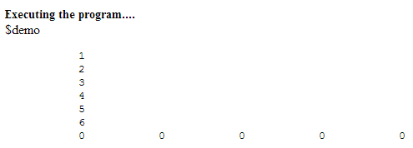
Trick Questions (Don’t be fooled)
program exam IMPLICIT NONE INTEGER :: array(5), i, k Do i=1,5 array(i) = i WRITE (*,*) (i) END DO WRITE (*,*) (i) DO k=5,1,-1 array(k) = mod(array(i-1), array(k)) END DO WRITE (*,*) (array(i), i=1,5) end program exam
Lets add a few more write statements so that we can understand what’s going on...
Trick: variable i gets incremented to 6!

Slide 19
Trick Questions (Don’t be fooled)
General Solution to these types of problems:
Know your stuff
Relax, its not worth that much anyway

Slide 20
Big O
How does the Upper bound complexity grow?
Its a measure of either run-time or resources (memory slots, etc.)

Slide 21
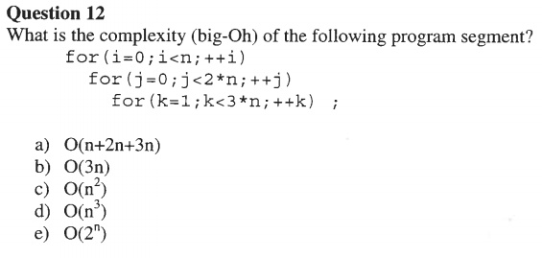
Big O
Taken from fall 2006 final

Slide 22
Big O
n
2n
3n-1
n*(2n)*(3n-1)
= 2n^2*(3n-1)
= 6n^3 - 2n^2
Take the highest order
Taken from fall 2006 final

Slide 23



Sorting Algorithms in Plain English
One pass of Bubble sort:
Start at the back
Swap if that element is less than the preceding
Move to the next element (continue till first element)

Slide 24

Sorting Algorithms in Plain English
One pass of Selection sort:
Find the smallest element
Swap it with the front

Slide 25
Sorting Algorithms in Plain English
One pass of Selection sort:
Find the smallest element
Swap it with the front
What would the array look like after a second pass?

Slide 26

Sorting Algorithms in Plain English
One pass of Selection sort:
Find the smallest element
Swap it with the front
What would the array look like after a second pass?

Slide 27

Sorting Algorithms in Plain English
1st pass:
One pass of Insertion sort:
Take an element from the rest of the list
Insert it to the sorted list
2nd pass:
3rd pass:

Slide 28
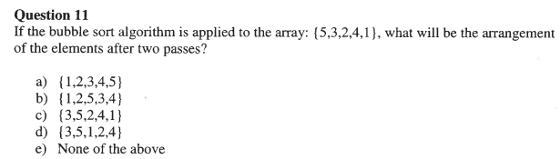
Sorting Pop Quiz
Taken from 2006 Fall Final

Slide 29


Sorting Pop Quiz
1st Pass:
Taken from 2006 Fall Final
2nd Pass:

Slide 30
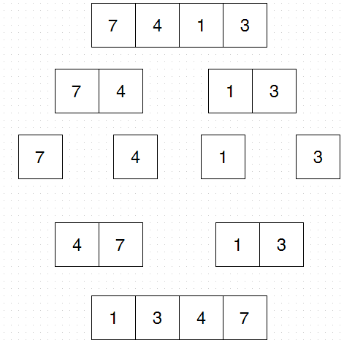
Sorting Algorithms in Plain English
Merge sort:
If list has only one element you are done
otherwise separate it into two lists
merge sort on first half
merge sort on second half
recombine

Slide 31
Recursion
#include <stdio.h> #include <string.h> int f(int x, int n){ if(n<4) return f(x+1,n+1) + f(x+2,n+1); else return x; } main() { printf("%i\n", f(0,0)); return 0; }
What is the output of the following Program?
Hint: expand the function

Slide 32
Recursion
Expand the recurrence relation:
f(x,4) = x
f(x,n)= f(x+1,n+1)+f(x+2,n+1)
f(0,0)
= f(1,1) +f(2,1)
= f(2,2) +f(3,2) + f(3,2) +f(4,2)
= f(3,3) +f(4,3) +f(4,3) +f(5,3) +f(4,3) +f(5,3) +f(5,3) +f(6,3)
=f(4,4)+f(5,4)+f(5,4)+f(6,4)+f(5,4)+f(6,4)+f(6,4)+f(7,4)+f(5,4)+f(6,4)+f(6,4)+f(7,4)+f(6,4)+f(7,4)+f(7,4)+f(8,4)
= 4 +5 +5 + 6 + 5 + 6 + 6 +7 + 5 +6 +6 +7 +6 +7 +7 +8
=96

Slide 33
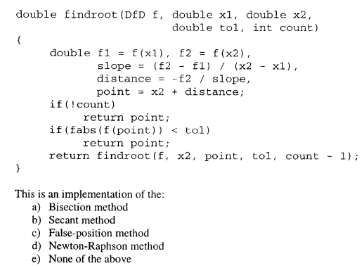
Numerical Methods
Taken from Fall 2005 final

Slide 34
Numerical Methods (root finding)
Passing functions as Arguments
typedef double (*DfD) (double); typedef double (*DfDD) (double, double); typedef double (*DfDDD) (double, double, double); double bisection_rf(DfD f, double x0, double x1, double tol);
f is of type DFD which is a function that takes a double as input and returns a double

Slide 35
Numerical Methods
How did I know? Because its the code copied from notes. Read your class notes!

Slide 36
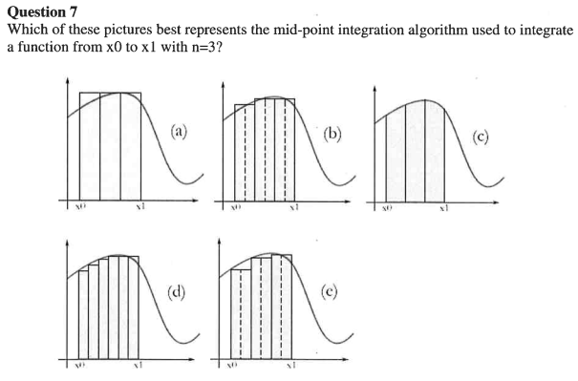
Numerical Methods (Integration)
Taken from winter 2007 final

Slide 37
Numerical Methods (Integration)
Mid point method evaluates the function at the middle of the interval
Taken from winter 2007 final

Slide 38
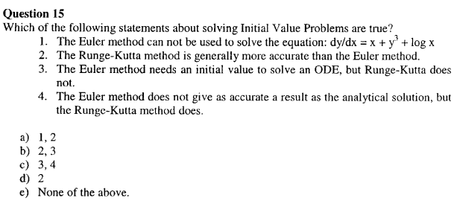
Numerical Methods (IVP)
Taken from Fall 2005 final

Slide 39
Numerical Methods (IVP)
false, Euler method is used for any first order ODE
true, euler method needs a smaller step size to achieve the same accuracy
false, these are all methods for solving initial value problems
false, All numerical methods have some error

Slide 40
Numerical Methods
Is there a trick to do these types of problems?
Yes. Memorize all the algorithms

Slide 41
Good Luck!

